Slide 1
IoT프로그래밍 3주차 과제
YA반 학번: 20202296 이름: 전채린

Slide 2
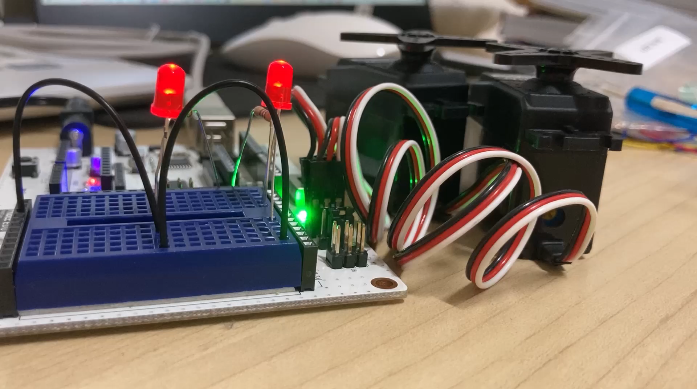
과제1 서보 중심 맞추기 동영상

Slide 3
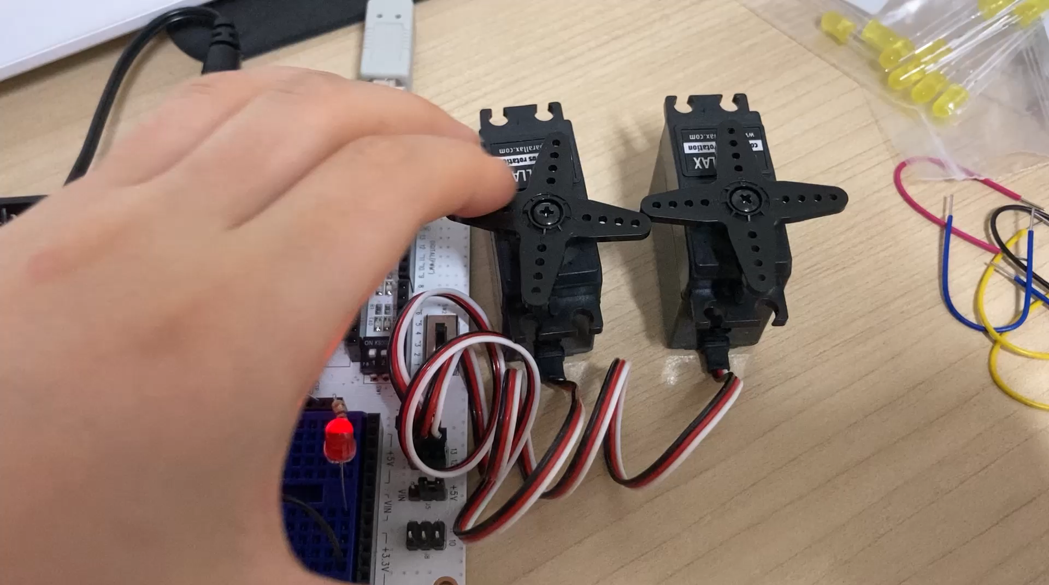
과제2 동작 영상

Slide 4
과제2 스케치
#include <Servo.h> // Include servo library
Servo servoLeft; // Declare left servo
Servo servoRight; // Declare right servo
void setup() // Built in initialization block
{
servoLeft.attach(13); // Attach left signal to pin 13
servoRight.attach(12); // Attach right signal to pin 12
servoLeft.writeMicroseconds(1300); // 1.3 ms full speed clockwise

Slide 5
과제2 스케치
servoRight.writeMicroseconds(1700); // 1.7 ms full speed counterclockwise
delay(3000);
servoLeft.writeMicroseconds(1500); // 1.5 ms stay still sig, pin 13
servoRight.writeMicroseconds(1500); // 1.5 ms stay still sig, pin 13
delay(1000);
servoLeft.writeMicroseconds(1700); // 1.7 ms full speed counterclockwise
servoRight.writeMicroseconds(1300); // 1.3 ms full speed clockwise
delay(2000);
servoLeft.writeMicroseconds(1500); // 1.5 ms stay still sig, pin 13
servoRight.writeMicroseconds(1500); // 1.5 ms stay still sig, pin 13
}
void loop() // Main loop auto-repeats
{ // Empty, nothing needs repeating
}

